Slide 1
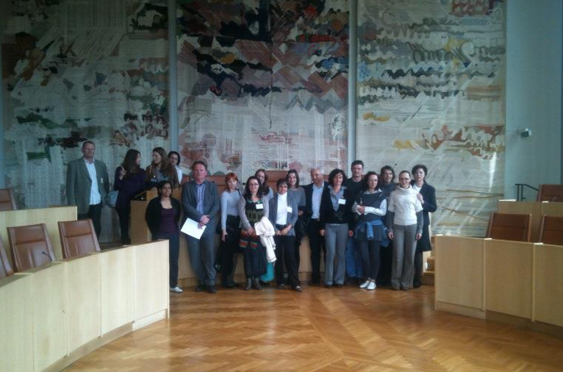
Study visit on
'Evidence-based Policy Making in Education and Training‘, Sweden 22-24 May 2012

Slide 2
Study visit on
'Evidence-based Policy Making in Education
and Training'
The aim of the study visit was to exchange experience concerning the use of evidence based policy making in the area of matching skills and labour market needs.
The Swedish National Agency for Higher Vocational Education participated on a workshop in Zagreb the 28 th February 2012. Togheter with the Croatian representatives we identifed relevant agencies to visit in Sweden.
The Croatian colleagues prepared questions of interest for the study visit . The questions was sent to several Swedish agencies witch responded with great interest.
The 22 of May 2012 the Swedish National Agency got the honor to host the participants from Croatia in Sweden.

Slide 3
Study visit on
'Evidence-based Policy Making in Education and Training'
Representatives from Statistics Sweden, Swedish Public Employment Service, Swedish Ministry of Education and Sience participated during the study visit.
The study visits was rewarding not only for the participants from Croatia but also for the Swedes.
Similar challenges in both contries, for examplen: no coordinated guidance system, the NQF is still an on going process in both countries ect.
We are looking forward to further cooperation in the field of evidence based policy making in area of matching skills and labour market needs!

Slide 4
A final report was made by the Croatian collegues including discussions and outcomes of the debates that took place during the visit.
The Swedish National Agency gathered papers and documents presented during the visit ( the PPT are available on the ETF webb).
We are looking forward to further cooperation in the field of evidence based policy making in area of matching skills and labour market needs!

Slide 5
Future skill supply in Sweden – analysis of present and future skills needs

Slide 6
Information about labour market and skills needs
Swedish Public Employment Service
Statistics Sweden
Swedish Agency for Economic and Regional Growth
Swedish agency for growth policy analysis
The Swedish National Agency for Higher Vocational Education
The National Board of Health and Welfare

Slide 7
Why?

Slide 8
To identify current and future skill gaps
To improve capability to anticipate changing skill needs
To match skills with labour market needs
To facilitate planning of education
For guidance to present and potential students
For information to the public in general

Slide 9
How?

Slide 10
Long term and short term forcasts
Surveys of empoyers
Sectoral, occupational, regional studies
Focus groups with relevant institutions, stakeholders, bransches (social partners)
Buisness intelligance

Slide 11
Swedish Public Employment Service
The Swedish Public Employment Service describes labour market trends. The forecasts are based on interviews with Swedish employers:
The long term forecast describes the demand for occupations in several industrises. The publications are issued once every year(outlook 5-10 years).
The short term forecast describes labour market demands of about 200 professions. The publications are issued twice a year (outlook 3-5 years).

Slide 12
The interviews are made by the staff at the Employment offices in all regions of Sweden.
The interviews includes questions about market development, capacity utilisation, shortage of labour, employment and recruitment.
The answers are used to make a index: Large surplus, = value 1, Surplus = value 2, Balance = value 3, Shortage = value 4 and Large shortage = value 5.

Slide 13
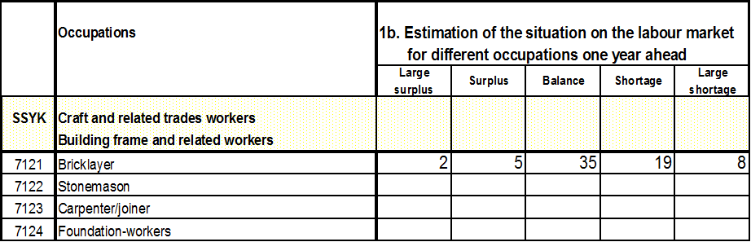
Shortage index
Shortage index: ((2*1)+(5*2)+(35*3)+(19*4)+(8*5))/69 = 3,38 = assessment: demand and supply are balanced for the Bricklayer occupation.

Slide 14
Statistics Sweden
Statistic Sweden describes trends and long term forecasts about demands and supply of skills. Trends are given for different skills. (Outlook to year 2030)
Statistic Sweden publishes a Labour Market Tendency Survey. The publicatios provides information about the labour market situation and an outlook for 72 educational and training categories. Of these, 58 are higher educational categories. The results are based on a questionnaire which is sent to a sample of employers.

Slide 15
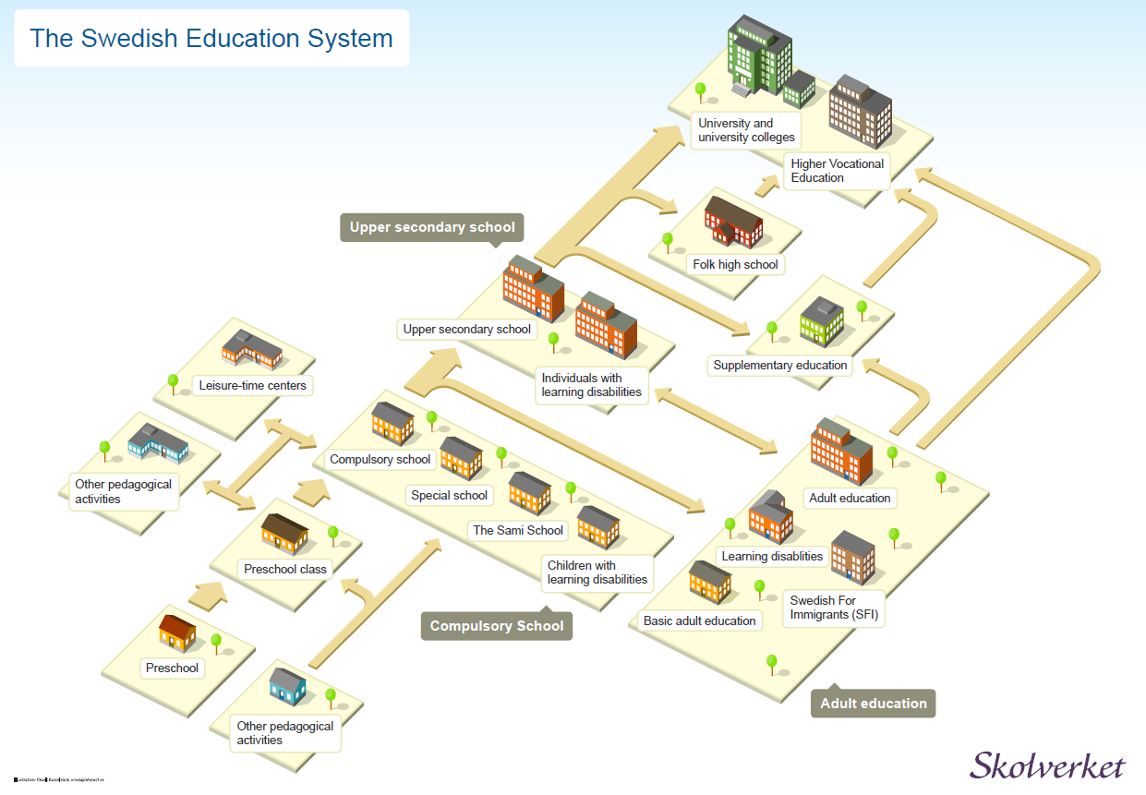

Slide 16
The Swedish National Agency for Higher Vocation Education
The Swedish National Agency for Higher Vocation Education provides information about demands and supply of specifik vocation skills (national, sectoral and regional).The outlook for these skills are based on information from several agencies and focusgroups.

Slide 17
Business intelligence
Study news and trends on the labor market and in the higher education sector
- identify forces that can affect the development on the labor market for example political trends, legislation, taxes, regulations or deregulations, technical development etc. thrue networking with key stakeholders and regional bodies.

Slide 18
Business intelligence
Networking
Communicate with networks on the labor market i.e. associations in different industries. For instance:
- Health care
- Tourism
- Agriculture and forestry
- Energy
Take part in networks with national, regional and local political operators and agencies.
- Regional associations (21)

Slide 19
National cooperation to assure matching of skills with labour market needs and EU Skills Panorama

Slide 20
National cooperation to assure matching of skills with labour market needs
In March 2010 the Swedish government requests the Swedish National Agency for Higher Vocational Education to coordinate studies of matching skills with labour market needs to assure needed competence that are required to improve employability.

Slide 21
Summary of results:
Establish one national authority responsible to hold and secure the sustainability of cooperation in skills area.
National agencies should provide support users in using data and methods of analysis
Data about labour market and skills needs should be accessible and comprehensive
The work with getting data more accessible and information coordinated has now started with EU skills panorama:
http://euskillspanorama.ec.europa.eu/

Slide 22

Thank you for your attention!

